Slide 1
MICROSOFT MOVIES ANALYSIS FRIDA OYUCHO FEBRUARY 16 2023

Slide 2
SUMMARY
This presentation aims to provide valuable insights into the movie landscape for Microsoft's emerging studio.
Leveraging this analysis can inform decision-making processes for budget allocation and content creation, optimizing the potential for high revenue returns.
This presentation summary captures the key findings, recommendations, and the overall significance of the analysis for Microsoft's movie studio. It serves as a concise and informative guide for stakeholders.

Slide 3
OUTLINE
Business Problem
Data & Methods
Results
Conclusions

Slide 4
BUSINESS PROBLEM
Microsoft is exploring top-performing genres in the current box office landscape for their new movie studio. This analysis aims to provide actionable insights on successful film trends to guide strategic decisions and ensure the creation of content that resonates with audiences, maximizing the studio's chances of success in the competitive entertainment industry.

Slide 5
Data & Methods
The dataset used were from:
tmdb database
tn.movie_budgets database
title.basics database
The project used descriptive analysis including a density plot representing the distribution of the numeric variables i.e. distribution of worldwide profit. The charts provide an insightful overview of Microsoft to identify genres with resource needs

Slide 6
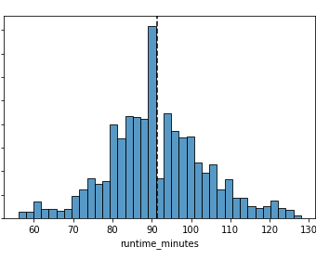
Results
The graph displays a right-skewed distribution, with most movies lasting 90-120 minutes. The mean runtime is around 108 minutes, with outliers on the right, possibly signifying epics or documentaries with longer durations.

Slide 7
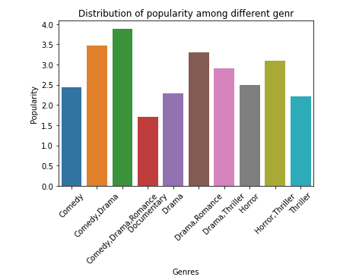
RESULTS
The graph displays a right-skewed distribution, with most movies lasting 90-120 minutes. The mean runtime is around 108 minutes, with outliers on the right, possibly signifying epics or documentaries with longer durations.

Slide 8
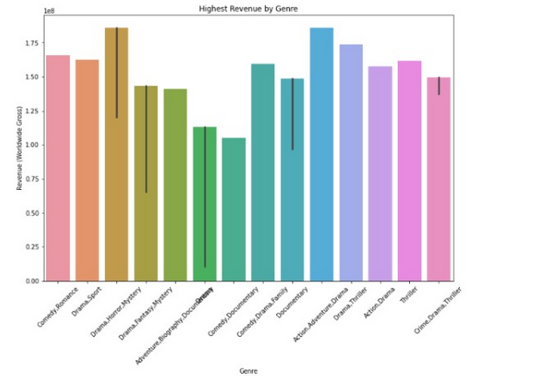
RESULTS
The graph below depicts that the Action genre yields the highest revenue, around 1.25 billion dollars, followed by Comedy, Drama, and Adventure genres with revenues of approximately 750 million, 500 million, and 400 million dollars respectively.

Slide 9
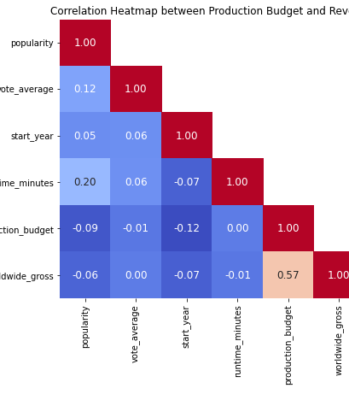
RESULTS
The heatmap highlights a strong positive correlation (0.57) between production budget and revenue, and weak negative correlations between revenue and start year, runtime, and some genres. It offers insights for data-driven decisions in movie production and distribution.

Slide 10

CONCLUSIONS
It is advisable to create movies that last between 90 to 120 minutes. This duration seems to align well with audience preferences.
Focus on producing more Comedy and Drama movies, as these genres appear to be the most popular among viewers. This could potentially attract a larger audience.
There is a strong positive correlation between production budget and revenue. This suggests that increasing the production budget might lead to higher revenue. However, it's essential to carefully assess the cost-benefit relationship to ensure profitability.
Consider prioritizing the production of Drama, Horror, and History genres, as they contribute to the highest revenue. This insight can guide content creation strategies for maximizing profitability.

Slide 11
Email: fridaoyucho@gmail.com GitHub: FridaOyucho LinkedIn: Frida Oyucho

